Slide 1
A. EJAS MOHAMED
Generative AI for Engineering (E2324)
IBM-EDUNET FOUNDATION
Email: ejasmohamed786@gmail.com
Reg No: 211521243052
Department of AI & DS
Panimalar Institute of Technology, Chennai
3/28/2024

Slide 2
PROJECT TITLE
Price predicting the Bitcoin price and the Google stock price using Deep Learning, RNN with LSTM layers with TensorFlow and Keras in Python

Slide 3

AGENDA
Problem Statement
Proposed System/Solution
System Development Approach
Algorithm & Deployment
Result
Conclusion
Future Scope
References

Slide 4
PROBLEM STATEMENT
The inherent volatility and unpredictability of financial markets pose a significant challenge for investors attempting to forecast future prices, particularly for assets like Bitcoin and Google stocks. Traditional forecasting methods frequently struggle to capture the intricate patterns within these markets, leading to suboptimal predictions. Therefore, there is a growing demand for advanced techniques such as deep learning to enhance the accuracy of price predictions.

Slide 5
PROPOSED SYSTEM
Project objective: Utilize deep learning methodologies, particularly Recurrent Neural Networks (RNNs) with Long Short-Term Memory (LSTM) layers.
Target assets: Bitcoin and Google stocks.
Approach: Analyze historical price data and relevant market indicators.
Model development goal: Create models adept at learning and capturing complex patterns within the data.
Prediction objective: Accurately forecast future prices of Bitcoin and Google stocks.
5

Slide 6
SYSTEM DEVELOPMENT APPROACH
Data Collection: Obtain historical price data for Bitcoin and Google stocks from reliable sources such as financial APIs or databases.
Data Preprocessing: Clean the data, handle missing values, and normalize the features to ensure compatibility with the neural network model.
Model Development: Implement RNN with LSTM layers using TensorFlow and Keras in Python. Design the architecture of the neural network, including the number of LSTM layers, neurons, and activation functions.
Model Training: Split the data into training and validation sets. Train the model on the training data and tune hyperparameters to optimize performance.
Model Evaluation: Evaluate the trained model using appropriate metrics such as Mean Absolute Error (MAE) or Root Mean Square Error (RMSE) on the validation set.
Prediction: Deploy the trained model to make predictions on unseen data, i.e., future prices of Bitcoin and Google stocks.

Slide 7
ALGORITHM & DEVELOPMENT
Recurrent Neural Networks (RNNs) with LSTM Layers:
RNNs are a type of neural network designed to handle sequential data by retaining memory of past inputs.
Long Short-Term Memory (LSTM) is a variant of RNNs that can effectively capture long-term dependencies in sequential data while mitigating the vanishing gradient problem.
LSTM layers are composed of memory cells and various gates that regulate the flow of information, enabling the model to learn and retain patterns over extended sequences.
TensorFlow and Keras:
TensorFlow is an open-source deep learning framework developed by Google, providing a flexible ecosystem for building and deploying machine learning models.
Keras is a high-level neural networks API, designed for ease of use, modularity, and extensibility. It is integrated with TensorFlow, allowing seamless model development and deployment.
Python Programming:
Python serves as the primary programming language for implementing the deep learning model, leveraging its extensive libraries and frameworks for data manipulation, model training, and evaluation.

Slide 8
ALGORITHM & DEVELOPMENT
Deployment:
Model Training:
Split historical data into training and validation sets, ensuring a time-based split for temporal consistency.
Train the RNN with LSTM model using TensorFlow and Keras on the training data, optimizing parameters through backpropagation and gradient descent.
Hyperparameter Tuning:
Experiment with hyperparameters like LSTM layers, neurons per layer, learning rate, batch size, and dropout rate to enhance model performance.
Utilize cross-validation or grid search techniques to systematically identify the best hyperparameter configuration.
Model Evaluation:
Evaluate the model using metrics such as MAE, RMSE, or MAPE on the validation dataset.
Analyze prediction accuracy and detect overfitting or underfitting issues.

Slide 9
ALGORITHM & DEVELOPMENT
Deployment Options:
Cloud Deployment: Host the model on platforms like GCP, AWS, or Azure, providing scalable access through APIs.
Local Deployment: Deploy the model locally or in containers for standalone usage.
Web Integration: Integrate the model into web applications or trading platforms for user interaction.
API Development: Develop RESTful APIs for real-time predictions and system integration.
Monitoring and Maintenance:
Continuously monitor model performance and retrain with updated data to adapt to market changes.
Implement version control and logging for tracking changes and debugging.
Ensure security measures to protect sensitive data and prevent unauthorized access.

Slide 10
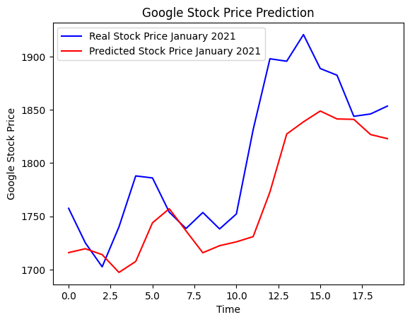
RESULT
10

Slide 11
CONCLUSION
The conclusion of this proposed work highlights the deep learning techniques, particularly RNNs with LSTM layers, show promising results in predicting the prices of volatile assets like Bitcoin and stocks. By capturing complex patterns in historical data, these models can assist investors in making informed decisions and managing risks in financial markets.
The Coding of the project is uploaded in GitHub, click below button to see the code :)
11

Slide 12
FUTURE SCOPE
Experiment with different architectures and hyperparameters to further improve prediction accuracy.
Incorporate additional features such as volume, sentiment analysis, and macroeconomic indicators for enhanced model performance.
Explore ensemble methods and hybrid models combining deep learning with traditional time-series forecasting techniques.
Extend the approach to other financial assets and markets beyond Bitcoin and Google stocks.

Slide 13
REFERENCES
GitHub Profile Link: EJAS MOHAMED
LinkedIn Profile: EJAS MOHAMED
GitHub Project Link: Project

Slide 14
“ANOTHER FORM OF MODERNIZATION IS CONSERVING ENERGY FOR THE FUTURE”
THANK YOU!

